Slide 1
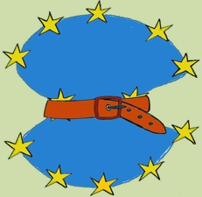
The Mercury Pills for the Union’s Social Ills :
Austerity and Labour Law in
Greece and Ireland
Eftychia Achtsioglou &
School of Law, Aristotle University of Thessaloniki
Michael Doherty
Department of Law, National University of Ireland

Slide 2
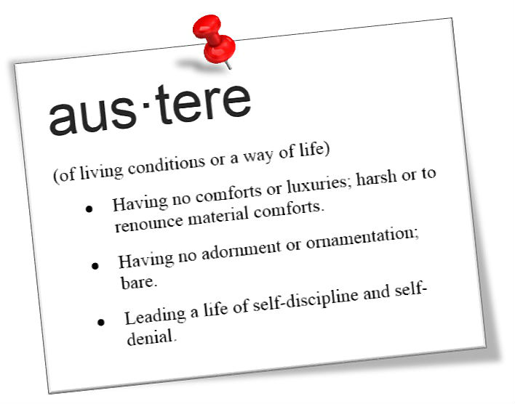
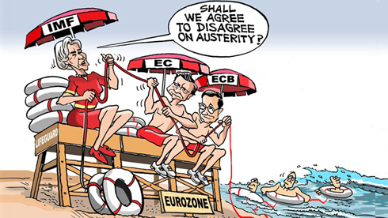
GREECE and IRELAND,
Came to the brink of economic collapse
Have been the recipients of ‘bail-out’ deals from the Troika
Agreed Memorandums of Understanding with the Troika
Pledged to undertake specified legal, economic and political reforms

Slide 3


The system of employment relations
Irish
Greek
Legislation – general framework of minimum working conditions
Art. 22(2) Greek Constitution
- protects collective autonomy of the social partners
- prohibits State intervention both in the bargaining procedure and in the content of collective agreements and arbitration awards
Favourability principle – any terms contained in a CA which are more favourable to workers prevail over the terms set by legislation.
Voluntarist – State provides supportive framework for collective bargaining
Employees have a constitutional right to form trade unions
Employers are not obliged to recognise a trade union for collective bargaining purposes
Social pacts 1987-2010– social partners (the State, the Unions, Employers) - issues of pay, tax reform , other socio-economic issues

Slide 4
The system of employment relations
Irish
Greek
Collective agreements (CA) reached through collective bargaining are binding
- National General Collective
Agreements (NGCAs) apply erga
- Enterprise-level agreements omnes
- Sectoral and occpational-level agreements apply to the members of unions which have subscribed to these agreements
Rule : Collective agreements do not produce erga omes effects
Exceptions : Agreements registered with the Labour Court produce erga omnes effects
-Registered Employment Agreements (REAs)- e.g. construction
-Agreements by Joint Industrial Councils (JICs); -Employment Regulation Orders (EROs) set legally binding minumum wages and conditions- e.g. retail, catering

Slide 5

The Crisis
1. GREECE – “ the epicentre of European crisis”
FINANCIAL CRISIS SOVEREIGN DEBT CRISIS CRISIS IN THE REAL ECONOMY
DEEP SOCIAL CRISIS
MAY 2010 - MoU 1 with the Troika MAJOR IMPACTS ON THE LABOUR MARKET
(Memorandum of Understanding)
SEVERE FISCAL CUTS
EXTENSIVE STRUCTURAL REFORMS
PAY CUTS FOR ALL PUBLIC SERVANTS
RESTRICTIONS ON PENSION RIGHTS
LAY-OFFs IN BOTH THE PUBLIC AND PRIVATE SECTOR
HIGHER RATE OF THE VALUE-ADDED TAX
(austerity measures)
DEEPER RECESSION

Slide 6
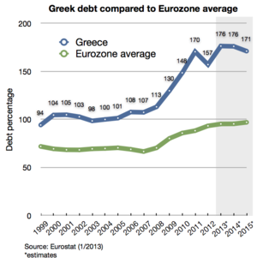

JULY 2011 – Greek Private Sector Involvement (PSI)
new coalition government
new bail-out combination package
still shrinking economy & unsustainable debt
FEBRUARY 2012 – MoU 2 with the Troika
new coalition government
OCTOBER 2012 – Revised Plan (new austerity package)
- 25000 public servants to be suspended by the end of 2014
- new pay cuts for public servants
- further cuts to already depleted pensions
- further welfare benefit cuts
- further deregulation of dismissal law

Slide 7

2013 - today
Public sector reforms
Reduce the number of public servants
Target: retire or dismiss 25000 public servants by the end of 2014 (12500 in 2013 and 12500 in 2014 set in a “non active” job status = suspended)
Privatization of core public enterprises (water, electricity etc)
Sale of public property
Health: Merge and closure of hospital units (reduce the total number of hospitals in Greece from 132 to 80).
Education: “Athena Plan” = mass closures of universities and technical institutions

Slide 8

2. IRELAND – “the social partnership juggernaut crashing to a halt”
DETERIORATION IN THE PUBLIC FINANCES COLLAPSE IN THE HOUSING MARKET AND CONSTRUCTION SECTOR
LIQUIDITY CRISIS FOR THE BANKING SYSTEM
MARCH 2009 – the government unilaterally introduced an emergency budget
(pay-cuts for all public servants)
DECEMBER 2009 – attempts to negotiate a new social pact collapsed
MARCH 2010 – Public sector Unions + Employers
4-year Public Service Agreement (the ‘Croke Park Agreement’)
NOVEMBER 2010 – MoU with the Troika (4-year austerity plan)
FINANCIAL SECTOR REFORMS
STRUCTURAL REFORMS TO THE LABOUR MARKET
REDUCTION IN THE NATIONAL MINIMUM WAGE (approx. 11,5%)
INDEPENDENT REVIEW OF THE REA AND JLC ARRANGEMENTS

Slide 9
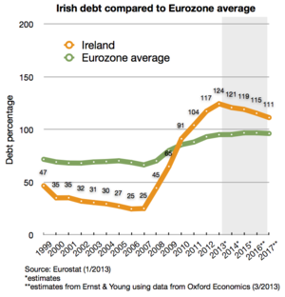

EARLY 2011 – new coalition government
further austerity measures
2013 – renegotiation of the Croke Park
Agreement
Croke Park Two
Haddington Road Agreement
PAY CUTS
INCREMENT FREEZES
SUBSTANTIAL CHANGES TO
WORKING CONDITIONS FOR PUBLIC SERVANTS
‘Negotiated’ with the public service trade unions

Slide 10


The Legislative Response
GREECE
IRELAND
Significant changes to workers protection laws
Core elements of the industrial relations system dismantled
Minimum wage (NGCA) 22%
Suspension of the ‘automatic wage increases-clauses’ until the unemployment rate falls below 10%
The favourability principle ABOLISHED
Changes in the arbitral regime
The influence of social partners
Transition from collective to individual bargaining
Fewer requirements in terms of reforming labour market regulations
The employment legislative framework has remained largely intact
Reconstituted ERO and REA systems (not abolition); The Industrial Relations Act 2012
BUT De-prioritising the role of the social partners
Focus on statutory minimum standards

Slide 11


Public sector reform
Law 4172/2013
Job positions may be abolished in the public sector and in the local government by decree of the Minister of Administrative Reform and of the Minister concerned ‘non-active’ employees for max 8 months = 75% of basic earnings dismissal
Abolition of specific job positions (school guards, municipal police throughout Greece, professors in specific disciplines)
2,114 teachers in technical vocational education
2,234 school guards
3,521 municipal police officers;
1,665 employees and medical staff in the Ministry of Health, who were working in eight hospitals in Athens and Thessaloniki that closed down on 27 August 2013.

Slide 12




Public sector reform
2013 – the Financial Emergency Measures
in the Public Interest Act (FEMPI)
members of unions that refuse to sign
the Haddington Road Agreement
pay cut
terms and conditions of employment altered by legislation
DEPARTMENT OF PUBLIC EXPENDITURE AND REFORM (DPER)
– determines pay and general employment terms

Slide 13



towards
Irish public sector centralised, command-and-control
industrial relations governance
DAMAGED RELATIONS OF TRUST WITH THE UNIONS
PUBLIC SERVANTS
WEAK TRADE UNION CENTRE
GOVERNMENT’S UNILATERAL WITHDRAWAL FROM SOCIAL PARTNERSHIP
UNILATERAL INSISTENCE OF THE RE-NEGOTIATION OF THE ORIGINAL CROKE PARK AGREEMENT
THREATS OF UNILATERAL ALTERATION TO PUBLIC SERVICE TERMS AND CONDITIONS OF EMPLOYMENT

Slide 14


Guarantees of social partner autonomy under European Law
Art. 11 of the European Convention on Human Rights guarantees the right to form and join trade unions
Art. 6 (3) of the new Treaty on European Union states that fundamental rights shall constitute general principles of the Union’s law
Art. 28 of the Charter of Fundamental Rights provides for the right of trade unions to negotiate and conclude collective agreements and, in case of conflicts of interest, to take collective action to defend their interests, including strike action.
Art. 152-155 of the Treaty on the Functioning of the EU states that the Union ‘recognises and promotes the role of the social partners’ at both Union and Member State level
LUXEMBOURG
Recent jurisprudence of the Court of Justice RUFFERT
militates against collective approaches to labour VIKING
market regulation. The ‘Laval Quartet’ judgements LAVAL
of the CJEU has severely restricted the rights of
trade unions to act in order to protect collective agreements in cases where
the rights of free movement of services or establishment are involved.

Slide 15



promoted by
Single market a particular form of governance regulatory
deeply interventionist
CJEU - Free Movement provisions status of Fundamental Rights
spill-over of MARKET INTEGRATION rules into almost all areas of national law
main principle of POLICY-MAKING
(any regulatory policy choice is assessed in terms of its ability to favour this specific model of market governance)
CJEU in ‘Laval Quartet’: ECONOMIC FREEDOM ‘the rule’
COLLECTIVE LABOUR RIGHTS ‘the exception’;
‘requires ‘THE SOCIAL to defend itself from THE ECONOMIC’

Slide 16


Albany [1996] : upheld national law provisions on collective agreements
competition law did not apply, as long as the CA was aimed
at improving working conditions
cf. Alemo - Herron v Parkwood Leisure Ltd [2011] – Art. 16 of the Charter - imposing collectively agreed terms (after the date of transfer) on a transferee
the transferee’s contractual freedom is ‘seriously reduced to the point that such a limitation is liable to adversely affect the very essence of its freedom to conduct a business’
MARKET ECONOMY RULES stable and unchangeable element, to which national legal orders should adjust
‘Euro Plus Pact’ - participating Member States must ‘review the wage setting arrangements, and, where necessary, the degree of centralisation in the bargaining process’
increasingly dominant intergovernmentalist approach to EU decision-making
‘Neo-liberal’ Ireland must be closely monitored; Heavily -regulated Greece must dismantle worker protections

Slide 17




AUSTERITY MEDICINE
ACCEPTED CURE FOR THE UNION’S ILLS
Fundamental questions around democracy (witness Euro elections 2014) young workers
migrants
trade unionists
The Economic and Financial Affairs Council (ECOFIN) dominance
Re-assertion of collective autonomy
necessary

Slide 18





Social partners + trade unions – more active role in terms of their participation in defining the rules which govern industrial relations at a transnational level
EU SOCIAL POLICY REGULATORY STATUS
REDISTRIBUTIVE STATUS
REINTRODUCTION OF POLITICAL AND LEGAL CONTROL OVER COMPETITION (possible? likely?..)

Slide 19

After the crisis, where next for (what remains of) ‘social Europe’?

